Slide 1
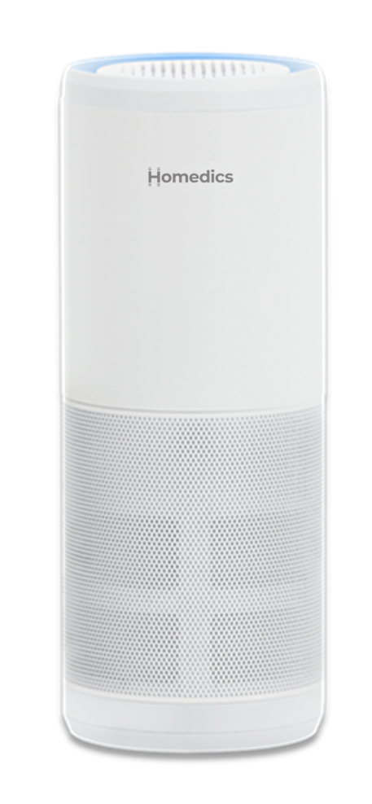


AP-P60-WT
portable air purifier P60
product features
360° HEPA-Type filtration removes up to 99% of airborne allergens as small as 2.0 microns
UV-C Technology reduces bacteria, virus, mold & fungus in the air
Activated carbon reduces odors
Prefilter captures large particles
2 speeds with whisper quiet fan
Accent lighting
Great anywhere from home to car to office
Fits in standard automobile cup holders
USB powered
Includes USB cord (USB wall charger not included)
Uses replacement filter, model AP-P60FL
product description
The Homedics Portable Air Purifier P60 uses UV-C Technology to reduce bacteria, virus, mold & fungus in the air, helping to keep your personal space a haven of health.
HEPA-type filtration removes up to 99% of airborne allergens while its activated carbon filter reduces odors. Plus, it fits in your car cup holder for travel.
Model | AP-P60-WT
UPC Code | 0-31262-10296-6 | Warranty | 1-Year
Product Dims | 2.62” W x 2.62” D x 6.69” H est. | Product Weight | 0.55 lbs. est.
Package Dims | 3.13” W x 3.13” D x 7.28” H est. | Package Weight | 0.78 lbs. est.
Case Dims | 10.13” L x 6.88” W x 8.00” H est. | Case Weight | 4.99 lbs. est.
Cube Dims | 0.32³ | Case Pack | 6

