Slide 1
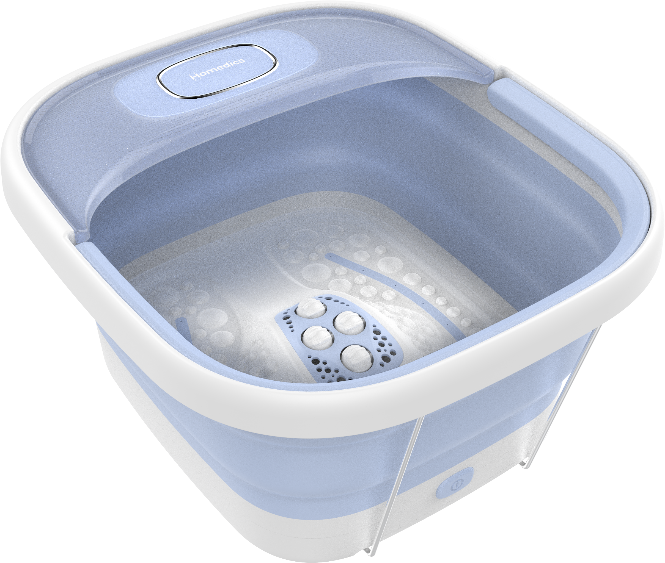

FB-72
smart space essential footbath​
product features
Patented Space saving
Safety-lock system to prevent folding when in use
Safe for use with your favorite bath salt
Heat Maintenance
Includes 2 packets of bath salts
Ergonomic Footbed - Rub your feet back and forth along the raised nodes and rolling center nodes for a pain-relieving massage
Convenient carry handle
product description
Our Smart Space Essential Footbath features invigorating bubbles and heat maintenance to relax and renew feet.
Model | FB-72
UPC Code | 0-31262-10972-9 | Warranty | 2-Year
Product Dims | 16.09” L x 14.49” W x 8.66” H est. | Product Weight | 3.97 lbs. est.
Package Dims | 14.92” L x 4.37” W x 16.69” H est. | Package Weight | 4.85 lbs. est.
Case Dims | 18.27” L x 15.51” W x 17.48” H est. | Case Weight | 21.16 lbs. est.
Cube Dims | 2.8665 ft³ | Case Pack | 4

