Slide 1
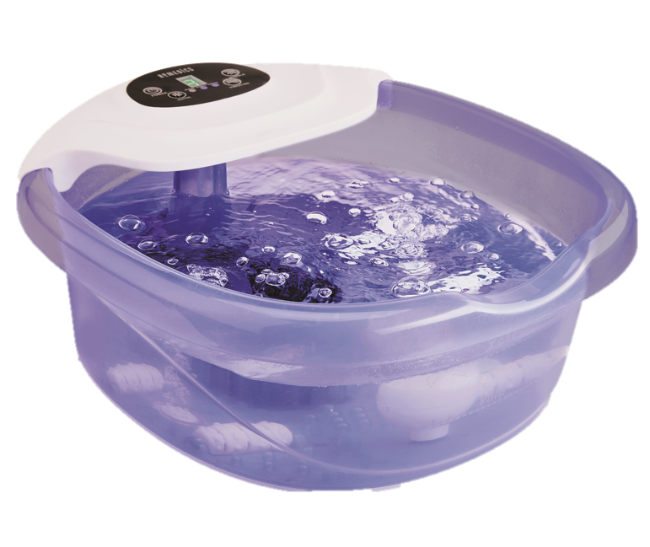

FB-500H
salt-n-soak footbath with heat boost
product features
Bubble Massage
Vibration Massage
Heat Boost Power with 3 temperature
settings
Integrated Splash Guard
Epsom Salt Dispenser
4 Manual Massage Rollers
Bonus Salt Starter Kit
Toe-Touch Controls
Corded Power Supply
product description
Salt build-up can clog the tubes of your footbath, causing the bubble feature to fail. Salt N Soak introduces new clog-eliminating technology allowing you to finally enjoy bubbles and bath salts together! Fill the Bath Salt Dispenser with your favorite bath salts for a soothing soak and includes an exfoliating pumice on top.
Model | FB-500H
UPC Code | 0-31262-10249-2 | Warranty | 2-Year
Product Dims | 16.4” L x 14.7” W x 7.9” H est. | Product Weight | 3.09 lbs. est.
Package Dims | 8.38” L x 14.63” W x 16.38” H act. | Package Weight | 4.95 lbs. act.
Case Dims | 17.75” L x 15.38” W x 17.38” H act. | Case Weight | 11.54 lbs. act.
Cube Dims | 2.7457 ft³ | Case Pack | 2

