Slide 1
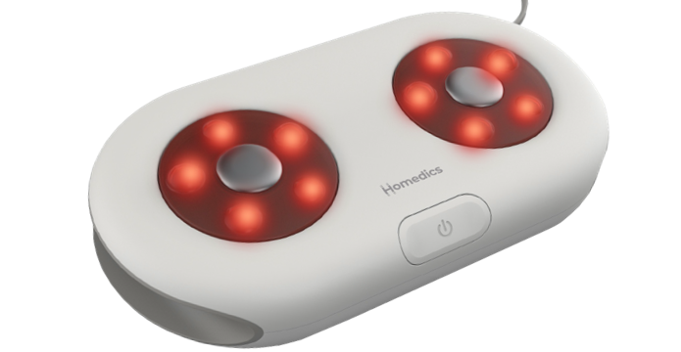

FMS-125HJ
maxComfort shiatsu foot massager with heat​
product features
Rotating Shiatsu massage nodes
Focused massage for balls, arches, or heels of feet
Soothing heat for added comfort
Maximum relief in a compact size
Perfect for use at home or office
product description
Glide your feet back and forth on the rotating Shiatsu nodes for a soothing massage.
The Comfort Glide Shiatsu Foot Massager with Heat delivers big time relief in a compact size.
Model | FMS-125HJ
UPC Code | 0-31262-10861-6 | Warranty | 1-Year
Product Dims | 9.92” L x 5.31” W x 2.09” H est. | Product Weight | 1.83 lbs. est.
Package Dims | 11.18” L x 3.23” W x 7.44” H est. | Package Weight | 2.54 lbs. est.
Case Dims | 11.89” L x 10.59” W x 8.62” H est. | Case Weight | 8.82 lbs. est.
Cube Dims | 0.6234 ft³ | Case Pack | 3

