Slide 1
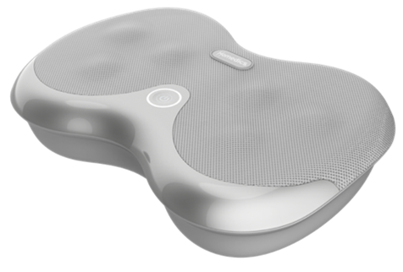

FMS-157HJ
shiatsu foot massager with heat​
product features
Counter-rotating Shiatsu massage nodes knead the sole of your feet
Eliminates soreness and promotes muscle recovery
Stimulates circulation and soothes aches
Soothing heat for added comfort
product description
Whether it from standing all day or walking in heels by the end of day our feet need relief!
The Shiatsu Foot Massager with Heat features deep-kneading shiatsu massage to help relax sore muscles and relieve pain.
Model | FMS-157HJ
UPC Code | 0-31262-10886-9 | Warranty | 1-Year
Product Dims | 13.5” L x 9.37” W x 3.94” H est. | Product Weight | 3.79 lbs. est.
Package Dims | 14.53” L x 4.88” W x 10.94” H est. | Package Weight | 4.74 lbs. est.
Case Dims | 15.55” L x 12.13” W x 15.24” H est. | Case Weight | 15.43 lbs. est.
Cube Dims | 1.6635 ft³ | Case Pack | 3

