Slide 1
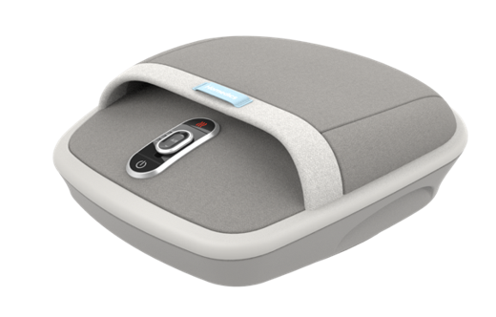

FMS-307HJ-GY
shiatsu air max foot massager with heat​
product features
Deep kneading rolling massage relaxes and soothes feet
Rhythmic air compression massage gently squeezes feet
Adjustable air intensity allows you to enjoy the perfect massage
Soothing heat for added comfort and relaxation
Adjustable Intensity
product description
The Shiatsu Air Max Foot Massager with Heat offers 2 massage styles. Deep-kneading rolling massage for unparalleled relaxation after a long day of standing or walking plus rhythmic air compression massage to squeeze out pains and aches and to have you feeling like yourself again.
Model | FMS-307HJ-GY
UPC Code | 0-31262-10912-5 | Warranty | 2-Year
Product Dims | 15.83” L x 14.76” W x 5.63” H est. | Product Weight | 7.96 lbs. est.
Package Dims | 7.75” L x 15.63” W x 17.0” H est. | Package Weight | 10.49 lbs. est.
Case Dims | 24.25” L x 16.25” W x 18.0” H est. | Case Weight | 31.46 lbs. est.
Cube Dims | 4.1048 ft³ | Case Pack | 3

