Slide 1
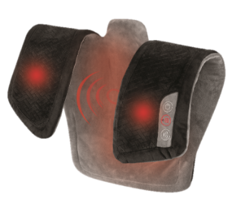



HCM-325H
vibration neck and shoulder wrap
Soothing Heat
Auto Off Timer
15 mins
product features
Vibration massage with 3 intensity levels
Integrated controls
Soothing Heat
2 Massage Styles
Customizable massage features
Soft, plush fabric
Corded power supply (Long 7ft Cord)
product description
Vibration massage works vigorously or gently (you control the intensity) to ease tension in your neck, shoulders, and back. 2 massage styles let you enjoy a soothing, steady vibration or an invigorating, pulsating massage.
Add soothing heat that permeates the entire soft, plush wrap to keep you warm and snuggly, while providing extra comfort for tired or sore muscles.
Model | HCM-325H
UPC Code | 0-31262-10845-6 | Warranty | 2-Year
Product Dims | 24.41” L x 24.41” W x 1.18” H est. | Product Weight | 2.35 lbs. est.
Package Dims | 3.13” L x 9.5” W x 12.0” H act. | Package Weight | 3.02 lbs. act.
Case Dims | 13.5” L x 10.0” W x ” H 12.63” est. | Case Weight | 12.09 lbs. est.
Cube Dims | 1.0188 ft³ | Case Pack | 4

