Slide 1
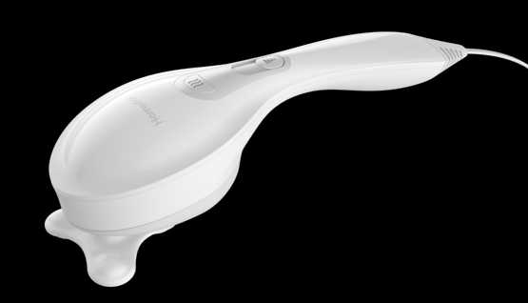
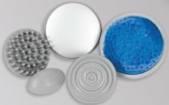

HHP-256HJ
hot & cold vibration massager​
product features
Vibration massage
Variable speed
Soothing heat to relax away pain
Soothing cold to reduce joint swelling and inflammation
5 interchangeable attachments
product description
The Homedics Hot & Cold Massager offers a vibration massage that melts away tension. The 5 interchangeable custom attachments provide a variety of massage therapies for comforting, soothing heat to targeted and pressure point relief. The variable speed option allows you to customize your massage and truly relax.
Model | HHP-256HJ
UPC Code | 0-31262-10808-1 | Warranty | 2-Year
Product Dims | 3.38” L x 6.38” W x 12.13” H est. | Product Weight | 2.2 lbs. est.
Package Dims | 3.25” L x 6.38” W x 12.0” H est. | Package Weight | 2.4 lbs. est.
Case Dims | 7.4” L x 6.93” W x 13.19” H est. | Case Weight | 4.8 lbs. est.
Cube Dims | 0.314 ft³ | Case Pack | 2

