Slide 1
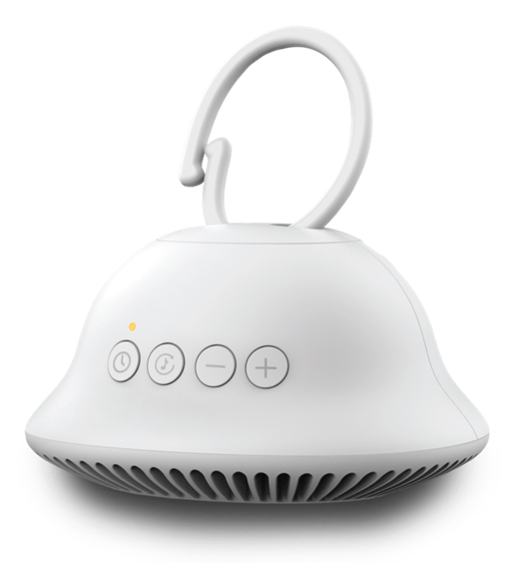
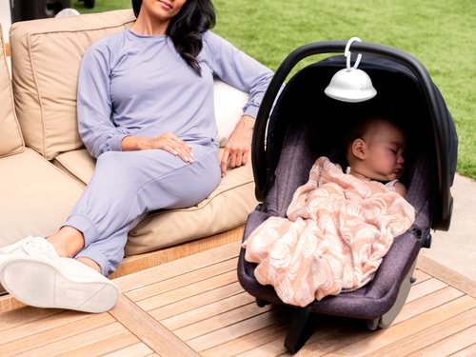

MYB-S120
soundsleep on-the-go
product features
  4 soothing sounds: heartbeat, shush, lullaby, white noise
  30-minute auto-off timer
  Integrated clip to easily attached to strollers, car seats, diaper bags, etc.
  Downward facing speaker for improved sound performance
  LED auto-off eliminates glow at night
  Frameable Bedtime Buddies artwork included
  Uses 3 AAA batteries
product description
Our updated SoundSleep On-The-Go design redefines portable soothing. The new downward facing speakers help to guide the 4 calming sounds directly to the baby without interference. It’s small and lightweight and conveniently clips onto strollers, car seats, diaper bags and so much more!
Model | MYB-S120
UPC Code | 0-31262-10450-2 | Warranty | 90-Days
Product Dims | 3.75” L x 2.0” W x 5.0” H est. | Product Weight | 0.43 lbs. est.
Package Dims | 4.25” L x 4.25” W x 3.13” H act. | Package Weight | 0.57 lbs. act.
Case Dims | 13.5” L x 9.5” W x 3.75” H act. | Case Weight | 3.41 lbs. act.
Cube Dims | 0.2783 ft³ | Case Pack | 6

