Slide 1
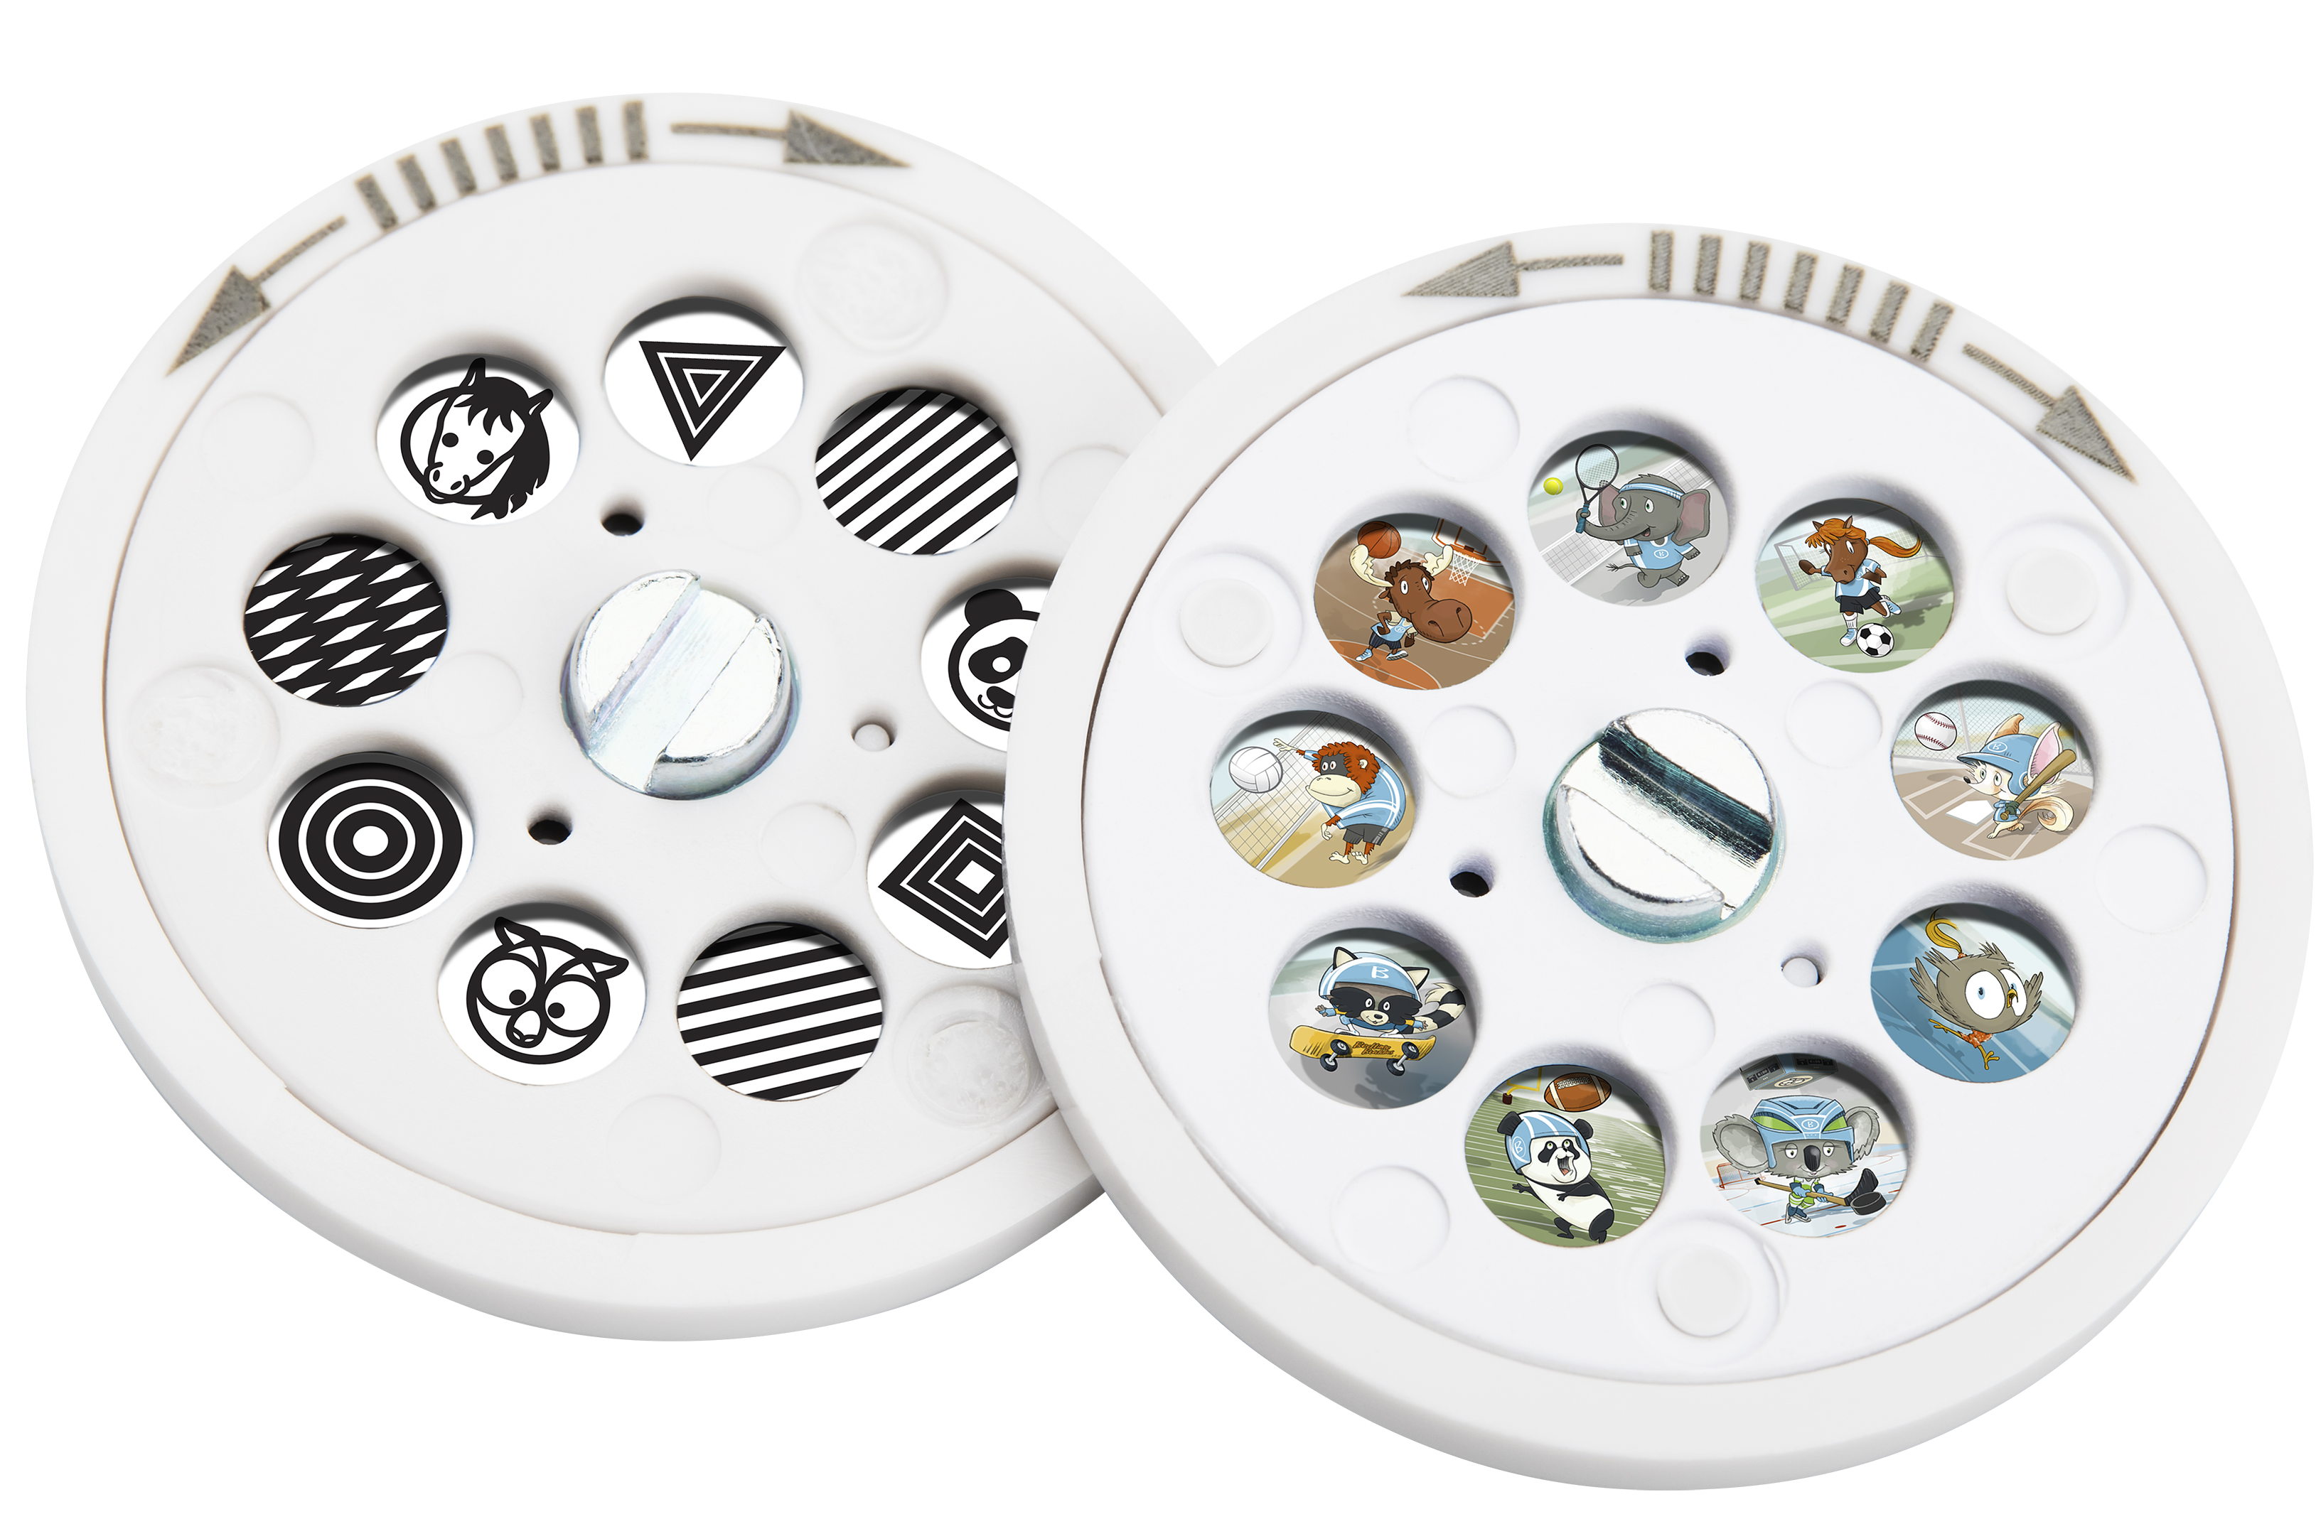

MYB-S315DSC1
projection image upgrade pack
Image discs are compatible with SoundSleep Lullaby (MYB-S315 & MYB-S305)
product features
Early Development Disc
Bold black and white images stimulate the development of the optic nerves and encourage cognitive development
Lines, patterns, shapes and bedtime buddy character silhouettes
Bedtime Buddies Sports Disc
Bedtime Buddies playing their favorite sports
From traditional sports like baseball and football to emerging sports like skateboarding, the disc offers fun projection options relatable to parents with growing children
product description
Additional image discs for more projection options for the baby to enjoy. This 2-Pack features an Early Development disc and a Bedtime Buddies Sports disc. A total of 18 new images to calm and lull your baby to sleep!
Model | MYB-S315DSC1
UPC Code | 0-31262-10621-6 | Warranty | 1-Year
Product Dims | 1.3” L x 1.3” W x 0.43” H est. | Product Weight | 0.01 lbs. est.
Package Dims | 0.38” L x 3.0” W x 5.38” H act. | Package Weight | 0.07 lbs. act.
Case Dims | 10.0” L x 9.0” W x 7.5” H act. | Case Weight | 4.43 lbs. act.
Cube Dims | 0.3906 ft³ | Case Pack | 60

