Slide 1
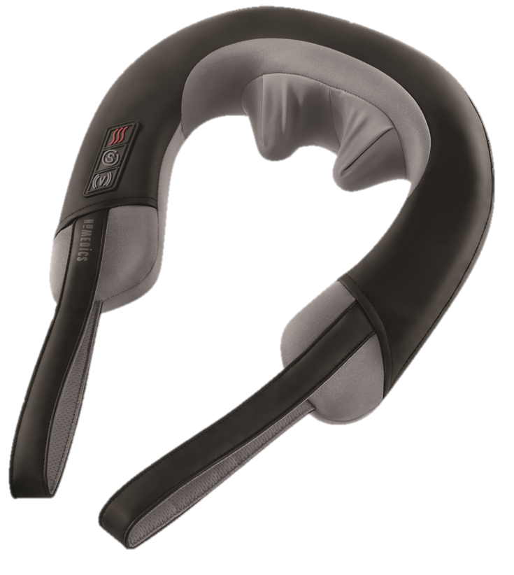

NMS-377HJ
pro therapy elite
shiatsu and vibration neck massager with heat
product features
Deep-kneading Shiatsu massage
Invigorating Vibration Massage
Shiatsu and Vibration can be combined or used separately
Soothing Heat
Long handles for gripping
Convenient integrated controls
product description
Whether it's leaning over your computer or hunching over your workbench, neck muscles can become tense and strained. Our Pro Therapy Elite Neck Massager is designed to melty away tension, eliminate tight knots, and help you to relax and unwind.
.
Model | NMS-377HJ
UPC Code | 0-31262-09351-6 | Warranty | 2-Year
Product Dims | 12.80” L x 12.80” W x 6.1” H est. | Product Weight | 1.14 lbs. est.
Package Dims | 5.88” L x 11.75” W x 12.5” H act. | Package Weight | 3.61 lbs. act.
Case Dims | 24.38” L x 12.75” W x 13.5” H act. | Case Weight | 14.35 lbs. act.
Cube Dims | 2.4285 ft³ | Case Pack | 4

