Slide 1
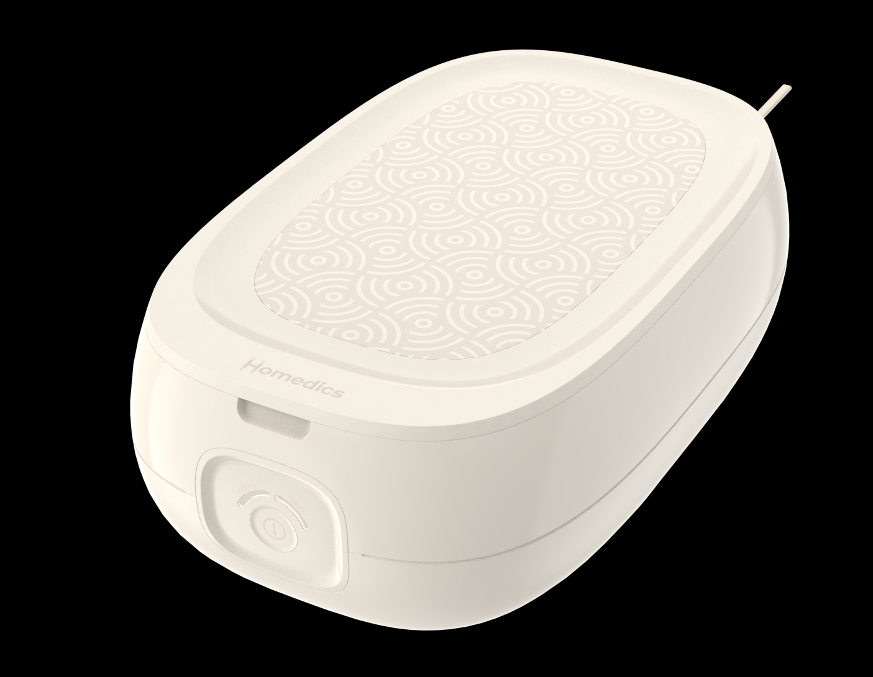
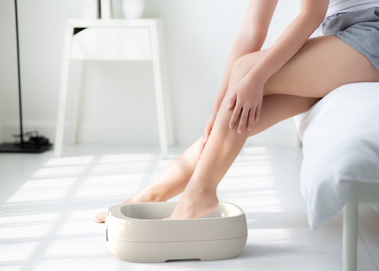

PAR-375H
theraspa deluxe paraffin bath
product features
Large tub size to fit hands, feet, or elbows
Ready to use in less than 1 hour
3 lbs. of additive–free, hypo-allergenic paraffin wax included
Corded power supply
Easy-to-use controls
Includes 20 plastic liners
product description
Oh, la-la. You’ll want to leave this out. This is the perfect addition to any at-home spa day or everyday bathroom aesthetic thanks to its premium finish and sleek design.
Paraffin opens your pores, softens callouses, and removes dead skin for silky, smooth skin on your hands and feet
Model | PAR-375H
UPC Code | 0-31262-10685-8 | Warranty | 2-Year
Product Dims | 16.26” L x 10.12” W x 6.69” H est. | Product Weight | 8.3 lbs. est.
Package Dims | 6.88” L x 17.38” W x 10.63” H act. | Package Weight | 9.69 lbs. act.
Case Dims | 22.0” L x 17.88” W x 7.63” H act. | Case Weight | 19.38 lbs. act.
Cube Dims | 1.7369 ft³ | Case Pack | 2

