Slide 1
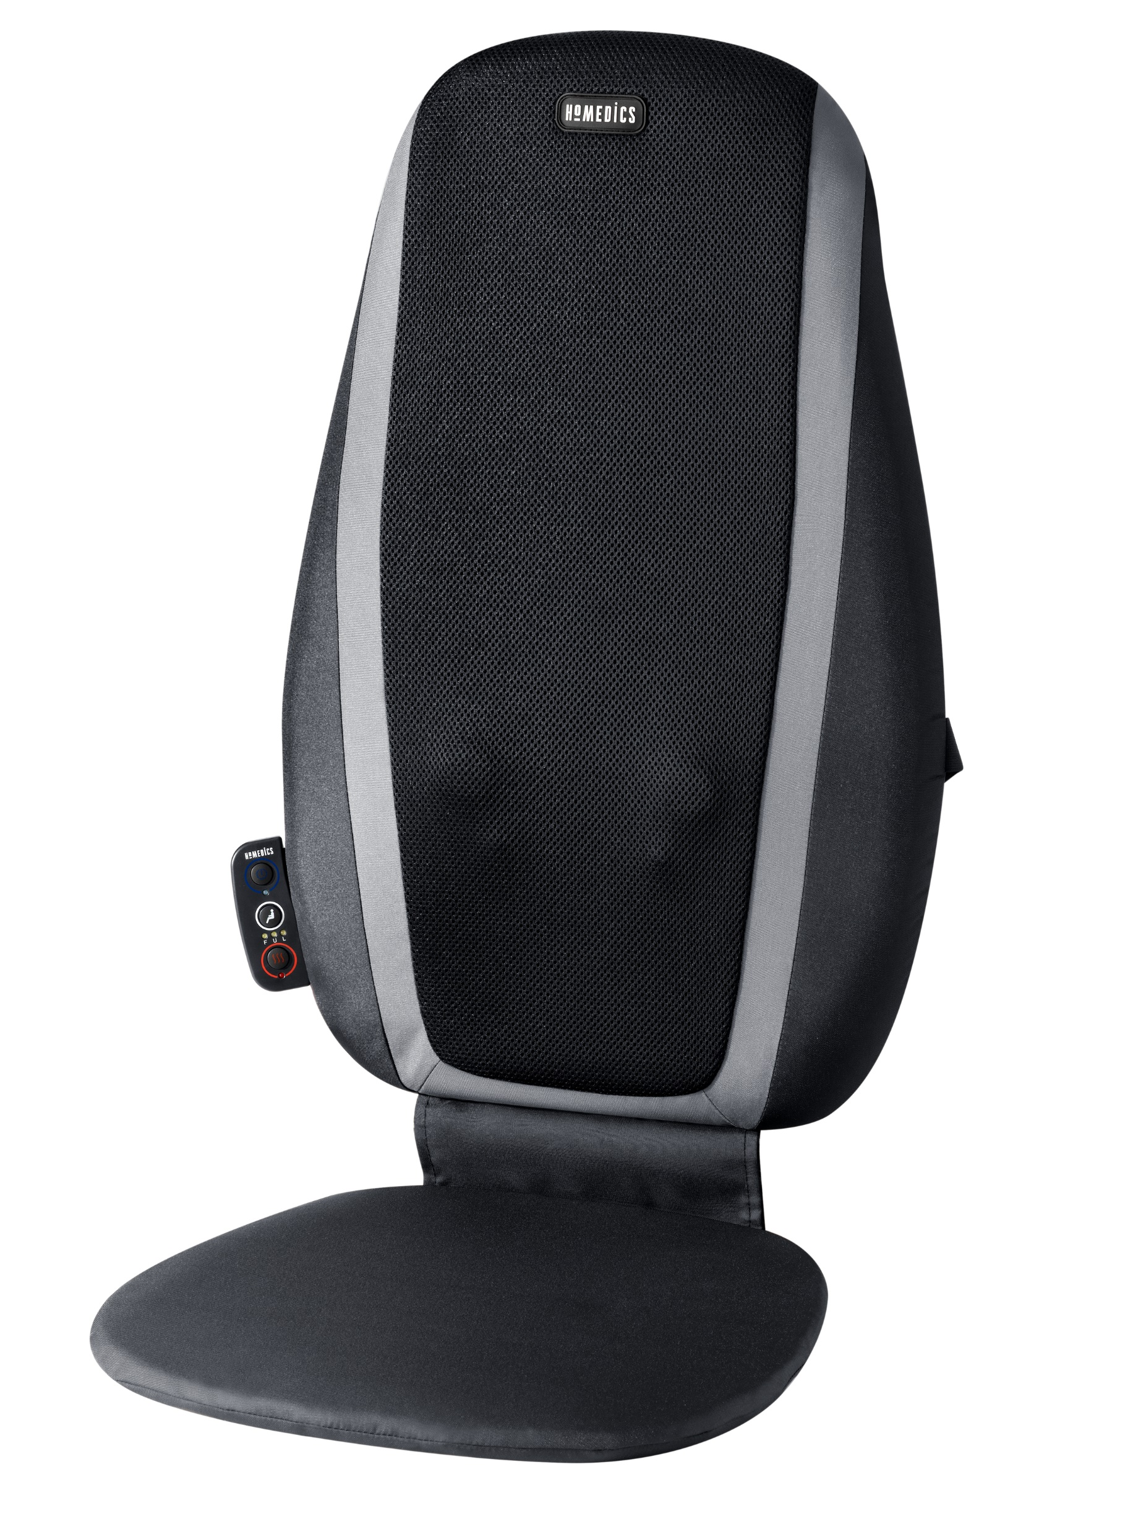

SBM-115HJ
shiatsu massage cushion with heat
product features
Kneading shiatsu massage nodes move up and down the back for a relaxing massage
Soothing heat enhances your massage experience
3 massage zones; isolate massage to the Upper or Lower back, or enjoy a Full back massage
Convenient integrated controls
product description
HoMedics Shiatsu Massage Cushion Kneading Shiatsu massage nodes move up and down the back for a relaxing massage Soothing heat enhances your massage experience 3 Massage zones; isolate massage to the Upper or Lower back, or enjoy a Full back massage Integrated controls for ease of use.
Model | SBM-115HJ
UPC Code | 0-31262-10250-8 | Warranty | 2-Year
Product Dims | 24.02” L x 15.55” W x 4.72” H est. | Product Weight | 6.47 lbs. est.
Package Dims | 4.75” L x 16.38” W x 25.38” H act. | Package Weight | 9.22 lbs. act.
Case Dims | 25.88” L x 10.0” W x 17.25” H act. | Case Weight | 18.44 lbs. act.
Cube Dims | 2.5835 ft³ | Case Pack | 2

