Slide 1
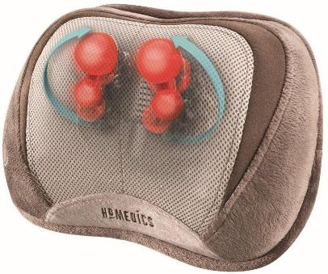
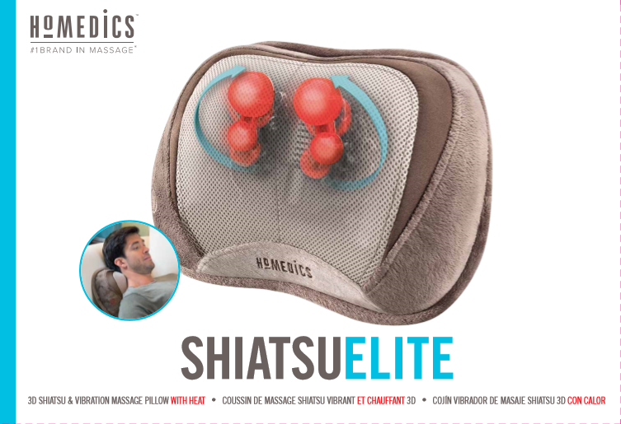
massage pillow
3d shiatsu & vibration
with heat
3D Technology delivers circular kneading plus in & out motion to relax and comfort tight muscles
Vibration Massage invigorates and melts away tension
Soothing Heat for added comfort
Versatile use for the neck, back and shoulders
Convenient Integrated Controls for ease of use
SP-100HA
0 31262 06445 5
13.78 X 10.43 X 5.12 inches act
14.75 X 4.75 X 10.25 inches act
15.50 X 15.25 X 11.00 inches act
1.54 ft³ act
2 Years
4.46 lbs act
5.22 lbs.act
15.66 lbs act
3
080218

