Slide 1
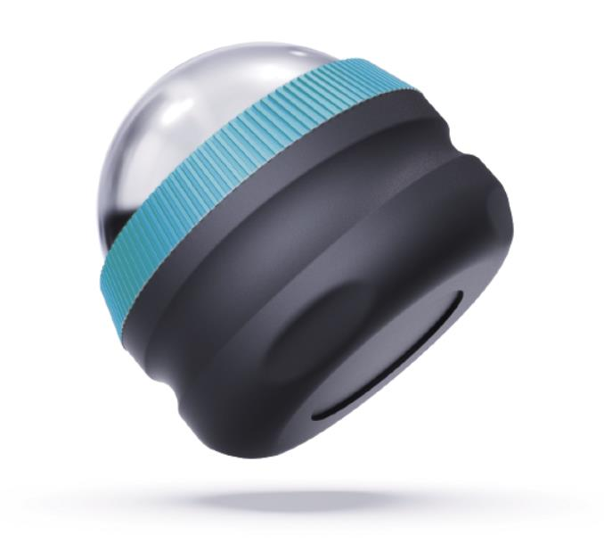

SR-10J
cryoglide roller​
product features
Metal ball, freezes in only 20 minutes and stays cold for up to 3 hours
Easy glide technology
Ergonomic grip
Designed for all hand sizes and ages
Easily travels in gym bags, duffels and luggage
product description
The Homedics CryoGlide Roller has a cooling and relaxing effect with technology that holds temperature for up to 3 hours. Perfect for soothing tired and tense muscles across the entire body.
Use after workouts to relax and reduce fatigue.
Model | SR-10J
UPC Code | 0-31262-10880-7 | Warranty | 1-Year
Product Dims | 2.56” L x 2.56” W x 2.56” H est. | Product Weight | 0.37 lbs. est.
Package Dims | 3.13” L x 4.13” W x 4.38” H est. | Package Weight | 0.60 lbs. est.
Case Dims | 9.88” L x 9.0” W x 5.25” H est. | Case Weight | 3.6 lbs. est.
Cube Dims | 0.2702 ft³ | Case Pack | 6

