Slide 1
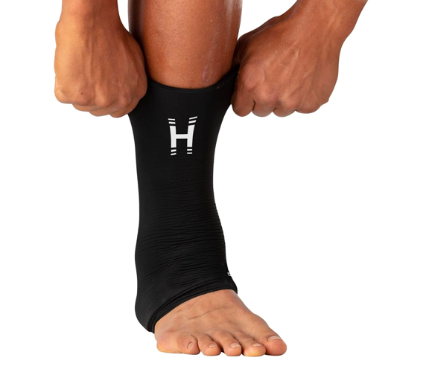




SR-GA800J
hot/cold gel ankle recovery sleeve​
product features
Wearable and reuseable gel sleeve for ankle.
Provides hot and cold therapy.
360-degree compression coverage
Ready in 2 hours (in freezer) or 30s in microwave​
Up to 20 minutes of relief.
Soothes sprains & strains, bumps and bruises, body aches, stiff joints, sore muscles, arthritis pain.
One size fits most
MOQ: 2,000pcs
product description
Ease tension in the ankles with the the Homedics hot & cold gel sleeves.
Store in the freezer for immediate use when needed. Stays cool for up to 20 minutes or soothing relief. Microwave for just 45s for comforting heat.
Perfect for relieving everyday tension and for soothing tired ankles.
Model | SR-GA800J
UPC Code | 0-31262-11200-2 | Warranty | 3-Year
Product Dims | 9.65” L x 3.94” W x 0.79” H est. | Product Weight | 1.12 lbs. est.
Package Dims | 2.25” L x 5.0” W x 6.25” H est. | Package Weight | 1.35 lbs. est.
Case Dims | 10.75” L x 7.88” W x 6.25” H est. | Case Weight | 8.0 lbs. est.
Cube Dims | 0.3064 ft³ | Case Pack | 6

