Slide 1
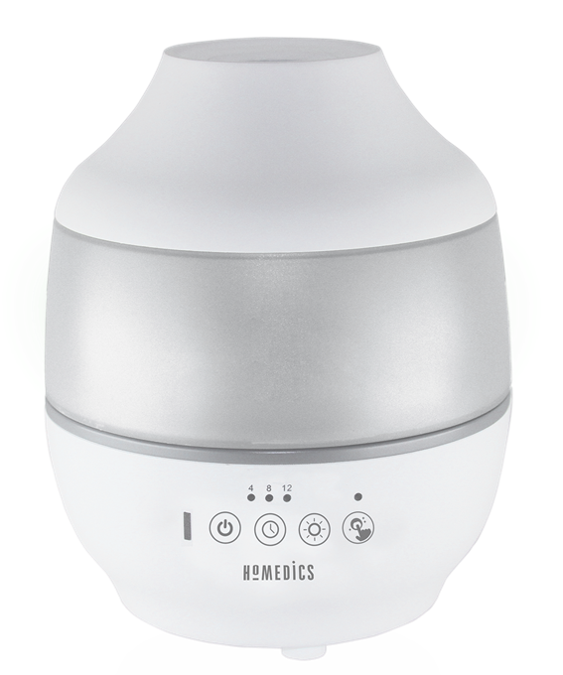


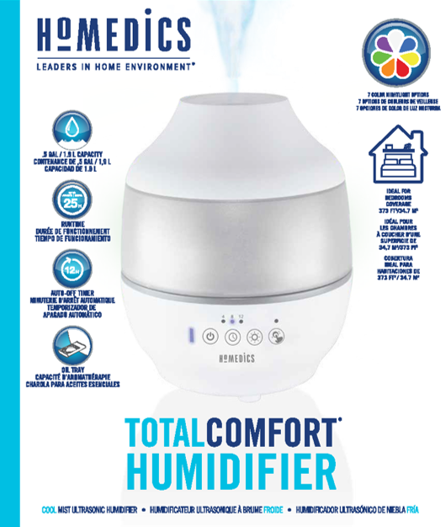
totalcomfort® ultrasonic humidifier
Visible ultrasonic cool mist
0.5 gallon/1.9 L water tank with handle
360⁰ mist nozzle
Up to 25-hour runtime
2 mist settings
Auto-off timer up to 12 hours
Coverage area: 373 ft²/34.6 m²
Great for medium-sized bedrooms and home offices
7 color night-light with on/off
Auto shutoff when out of water
Clean transducer/ultrasonic membrane indicator
Clean Tank Technology helps protect the tank from mold and mildew
Essential oil tray with 3 pads
Includes 1 demineralization cartridge
Model | UHE-CM18
UPC Code | 0-31262-09015-7 | Warranty | 2-Years
Product Dims | 7.0” L x 7.0” W x 8.5” H est. | Product Weight | 2.2 lbs. est.
Package Dims | 8.8” L x 8.8” W x 10.25” H est. | Package Weight | 3.5 lbs. est.
Case Dims | 18.4” L x 9.4” W x 11.0” H est. | Case Weight | 7.9 lbs. est.
Cube Dims | 1.10 FT³ | Case Pack | 2
111621

